Slide 1

Teaching Resources and Instructors’ Guidelines
Chapter 3: Managing innovation as a core business process

Slide 2
Chapter 3: Managing innovation as a core business process
In the following PowerPoint slides you will find the key headings from CHAPTER 3 together with the main illustrations, tables, etc.
There are also slides summarizing the key messages in bullet-point fashion, and a wide range of activities which you can use to help students explore around these themes.
Finally there are some reflection questions which can be used as the basis for discussion or assignments.

Slide 3
Learning Objectives
By the end of this chapter you will understand:
Innovation as a process rather than a single flash of inspiration;
The difficulties in managing what is an uncertain and risky process;
The key themes in thinking about how to manage this process effectively.

Slide 4

Size
Innovation is a journey, not an event
Sector
Search
For profit/not for profit
Stages in the journey
Contingency model – it all depends
Select
Regulatory environment
Implement
Capture value
Social innovation
Learn and build capability
Managing innovation as a core business process
Geography
Innovation life cycle
Innovation
strategy
Key influences
Innovative organization
Changing innovation models
Learning to manage innovation
Pro-active
linkages
Problem of partial models
Concept of routines
Dynamic capability

Slide 5

Core themes and material from the book

Slide 6
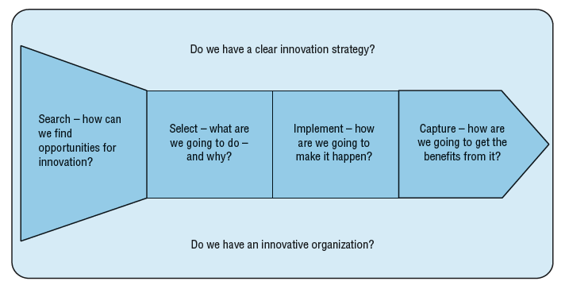
Innovation as a journey

Slide 7
Key stages in the process
  Searching for trigger ideas.
  Selecting from the possibilities the one we are going to follow through.
  Developing the idea from initial ‘gleam in the eye’ to a fully-developed reality.
  Managing its diffusion and take up in our chosen market.
  Capturing value from the process.

Slide 8
Innovation needs:
  Strategy;
  Innovative organization;
  Proactive linkages;
  Learning and improvement loop.
Influences on the process

Slide 9
Do we search as well as we could?
How well do we manage the selection and resource acquisition process?
How well do we implement?
Do we capture value? Improve our technical and market knowledge for next time? Generate and protect the gains so they are sustainable?
Do we learn from experience? How do we capture this learning and feed it back into the next time?
Key questions about how we manage innovation

Slide 10
For a start-up entrepreneur the ‘search’ stage is often called ‘opportunity recognition’ – but once they have spotted something they think they can exploit the challenge is of making it happen. They have to acquire resources making various pitches to get backing and buy-in.
Then they have to develop the venture and finally launch it into their chosen marketplace and capture the rewards and also the learning to allow them to do it again.
Different versions of the core process model

Slide 11
For a new product development team in a company it is about searching for ideas (maybe in the R&D lab, maybe via customer survey, maybe some combination of both). Then they have to secure internal resources – pitching for backing against other competing projects form different teams. Then they manage the development process, bringing the product through various stages of prototyping and simultaneously developing the market and launch plans. Finally launch and, hopefully, widespread adoption – and capturing the gains in commercial terms but also in terms of what has been learned for next time.
Different versions of the process model (continued)

Slide 12
For a public service team in a hospital the search may be for more efficient ways of delivering the service under resource constraints. Once again an individual or team has to convince others and secure resources and the permission to explore, they have to develop it and then diffuse it as a new method to an internal market of people in the service who will adopt the new way. And once again they capture value, in terms of efficiency improvement but also in learning.
Different versions of the process model (continued)

Slide 13
For the social entrepreneur it is about finding a trigger need, then developing and sharing a vision around how to meet that need better. Securing support and buy in is followed by development, implementation and hopefully widespread adoption – and the value is captured in social improvements as well as learning.
Different versions of the core model (continued)

Slide 14
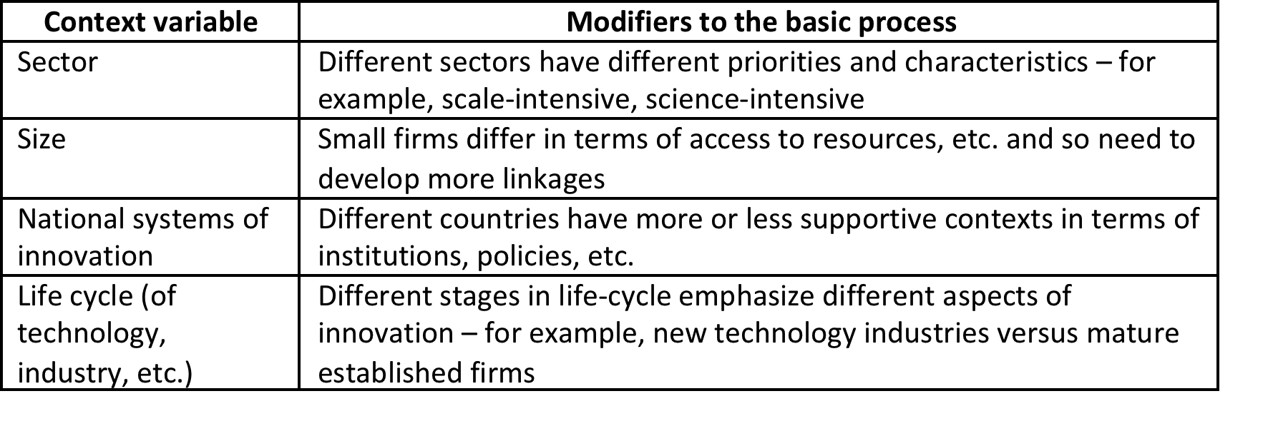
Variations on a theme

Slide 15
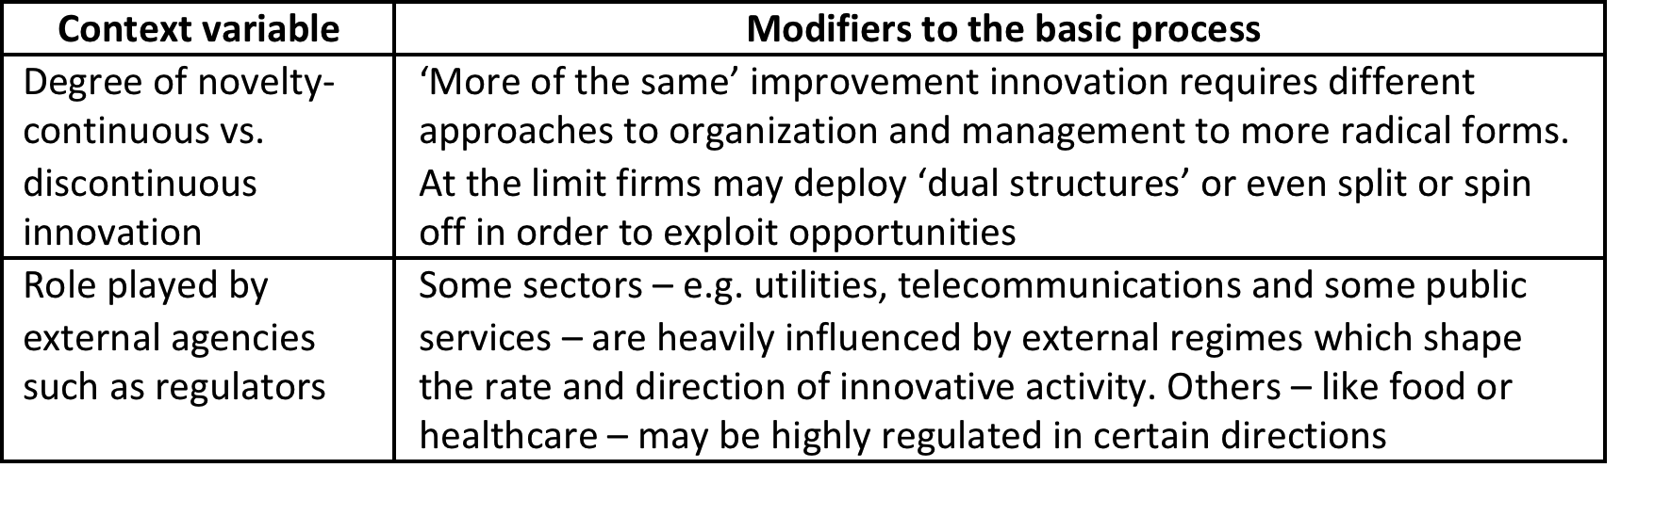
Variations on a theme (continued)
We can use a process model as a framework reminding ourselves the reality will vary, for example, by the sector, the size of our enterprise, or the stage in the industry life-cycle.

Slide 16
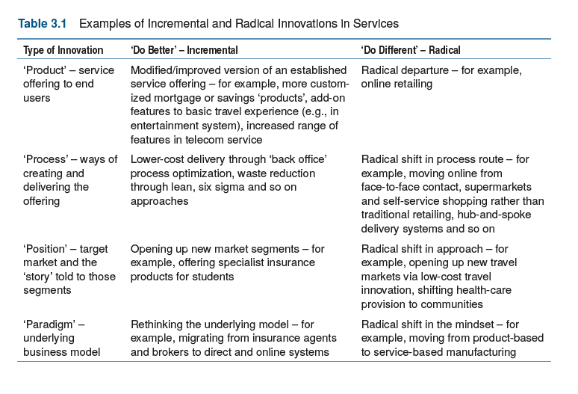
Different sectors, different approaches

Slide 17
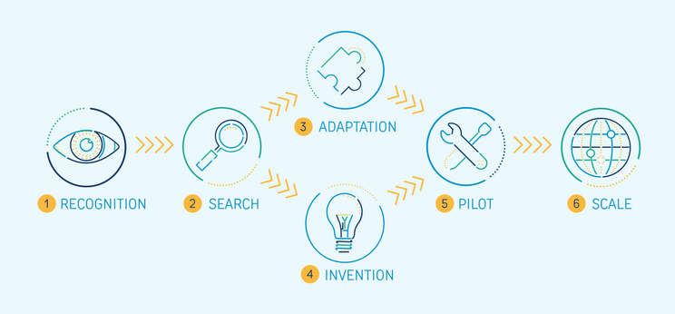
Innovation in the humanitarian world
https://higuide.elrha.org/toolkits/get-started/innovation-process/

Slide 18
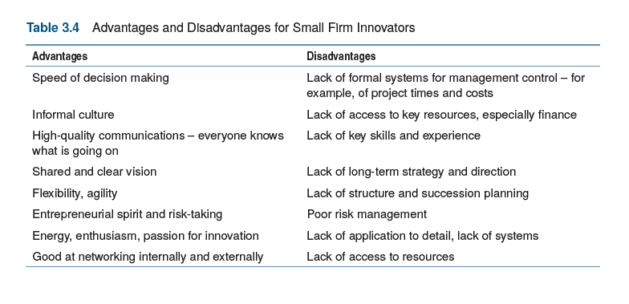
Size as an influence

Slide 19
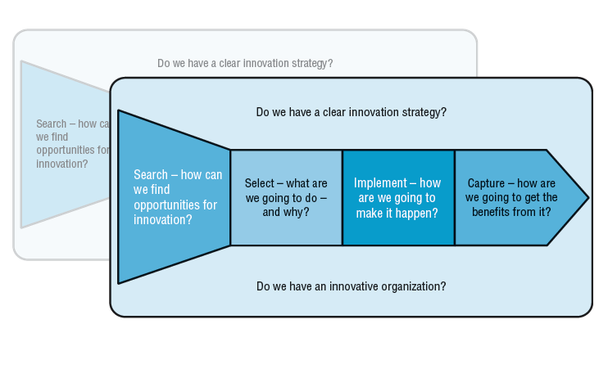
Different models for ‘steady state’ and discontinuous innovation

Slide 20
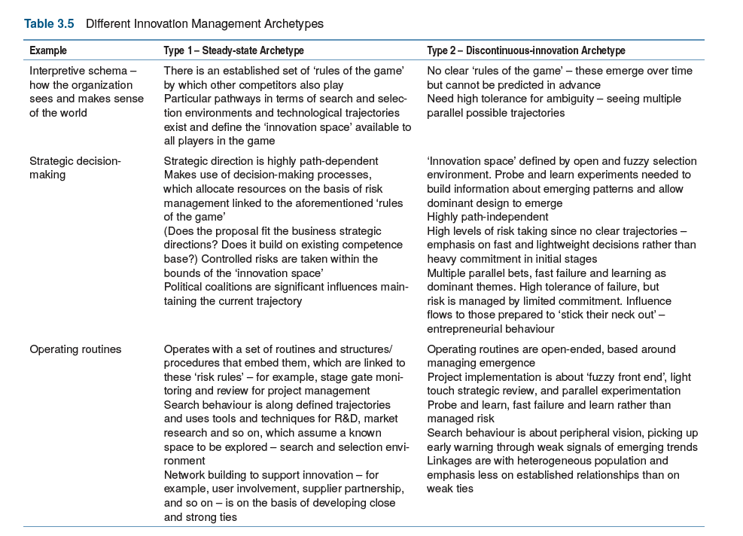

Slide 21
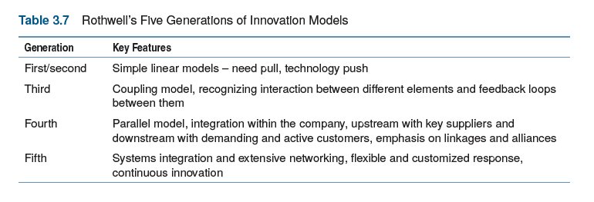
Changing models of innovation over time

Slide 22
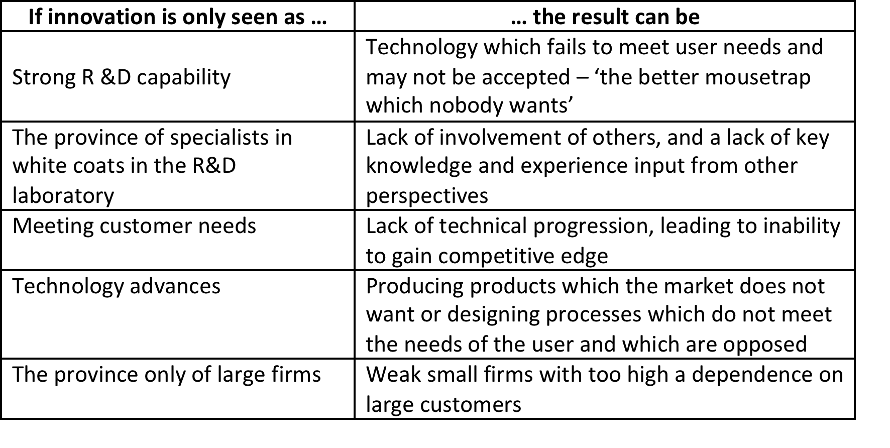
The problem of partial models

Slide 23
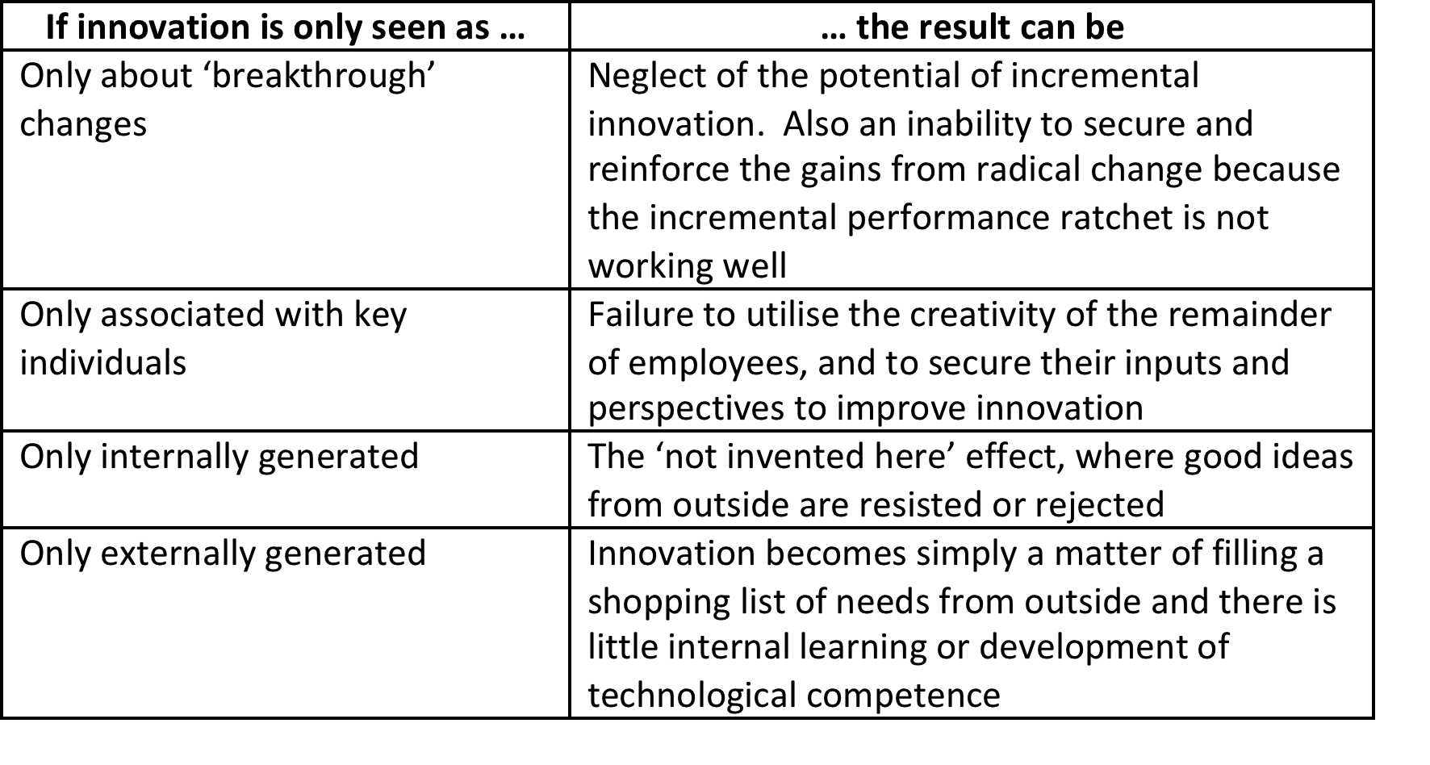
The problem of partial models (continued)

Slide 24
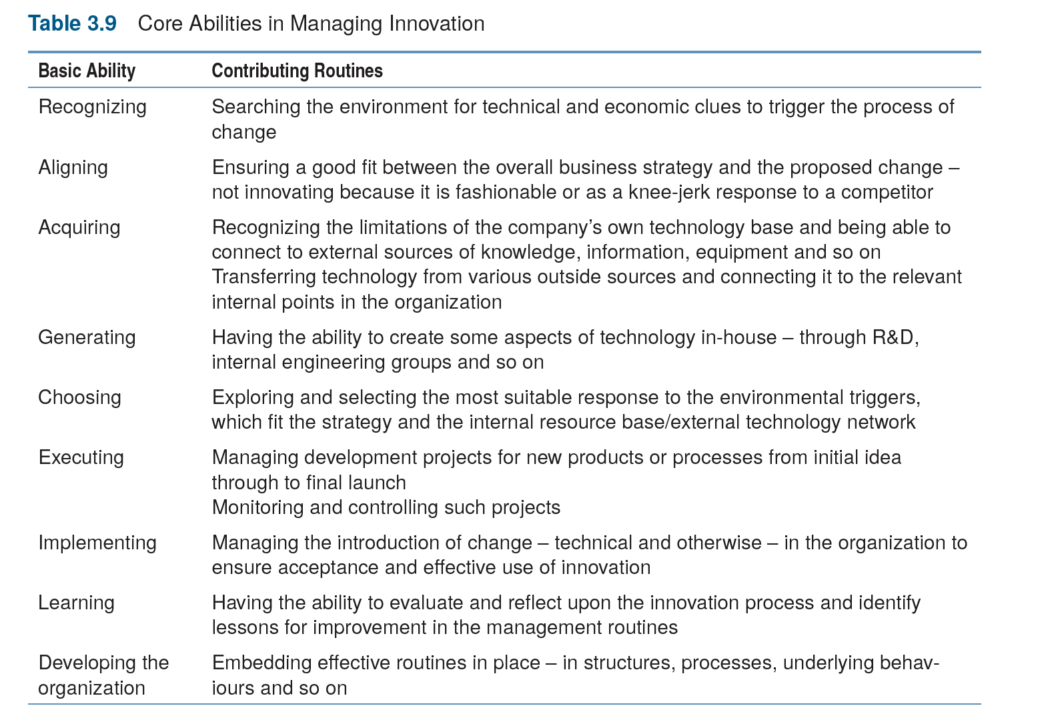
Core abilities in innovation

Slide 25
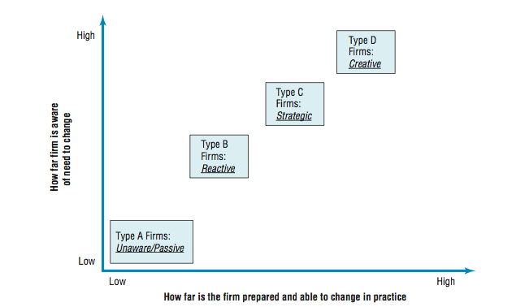
Developing innovation capability

Slide 26
Innovation as a journey

Slide 27
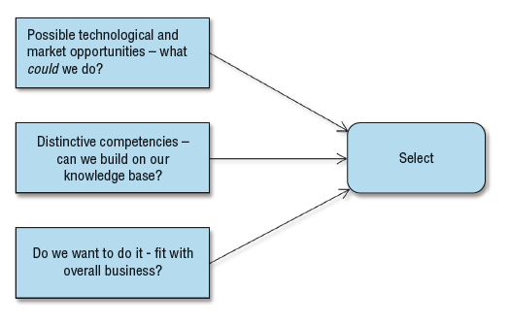
Key questions in the selection phase

Slide 28
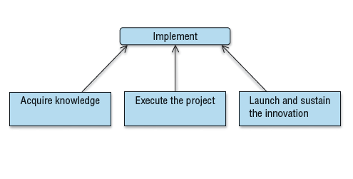
Key questions in the implementation phase

Slide 29
Dynamic capability
Dynamic capability – need to update and change our routines in a changing world.
Of the ways we do things round here – our routines – for innovation:
  Which should we do more of?
  Which should we do less of, or even stop?
  Which new things do we need to learn to do to add to our repertoire?

Slide 30
Summary
Innovation doesn’t happen simply because we hope it will – it’s a complex process which carries risks and needs careful and systematic management
It’s an extended process of picking up on ideas for change and turning them through into effective reality. At its heart it involves stages of searching, selecting, implementing and capturing value.

Slide 31
Summary
This core process doesn’t take place in a vacuum – we know it is strongly influenced by many factors. In particular innovation needs:
  Clear strategic leadership and direction, plus the commitment of resources to make this happen.
  An innovative organisation in which the structure and climate enables people to deploy their creativity and share their knowledge to bring about change.
  Pro-active links across boundaries inside the organisation and to the many external agencies who can play a part in the innovation process – suppliers, customers, sources of finance, skilled resources and of knowledge, etc.

Slide 32
Summary
  Do we have effective enabling mechanisms for the core process?
  Do we have strategic direction and commitment for innovation?
  Do we have an innovative organisation?
  Do we build rich pro-active links?
  Do we learn and develop our innovation capability?

Slide 33
Summary
Learning to do this – building innovation management capability – involves finding behaviour patterns which work and then reinforcing and practicing them until they become ‘routines’ – ‘the way we do things around here’
They become the structures and procedures through which we make innovation happen
In a constantly changing environment it’s also important to check and adapt our ‘routines’, updating, adding and even letting some of them go. This process of regular review and reconfiguration is at the heart of innovation management as a ‘dynamic capability’.

Slide 34

Videos
There are several videos which can help explore and present the key themes of the chapter:
The innovation journey
Preparing for the journey
Making the journey
Contexts and contingencies
A longer film looking at the question of managing innovation as a process

Slide 35
Videos
These interviews present people talking about the challenges of managing innovation in different contexts:
Michael Bartl of Hyve, a German consultancy which specialises in innovation management. It explores the use of new approaches to ‘crowdsource’ ideas and identify user needs.
Catherina van Delden, founder and CEO of Innosabi, discussing user involvement in innovation.
David Simoes-Brown of 100% Open discussing some of the innovation management challenges involved in working with the new ‘open innovation’ environment. Here is another interview with him

Slide 36
Videos
Helle-Vibeke Carstensen discussing some of the challenges of enabling innovation in the public sector.
Divya and Gaurav Garg talking about platform innovation for community development
Suzana Moreira of Mowoza.com taking about innovation in a development aid context
Simon Tucker discussing social innovation
Lynne Maher talking about innovation in a health care context

Slide 37
Videos
Kyle Stewart of Torbay Hospital in the UK talks about how innovation is supported and stimulated
Two doctors describe an innovation project they conducted as junior doctors looking to improve the service offered at Torbay Hospital.
Kate , another junior doctor at Torbay Hospital, describes an innovation project she carried out to improve the process for dealing with anaphylatic shock.

Slide 38
Videos
Joe Tidd explores the challenges in developing an innovation process
John Bessant explores the need for dynamic capability
A number of practising innovation managers talk about their experiences here

Slide 39
Blogs and podcasts
There are several podcasts picking up key themes around managing innovation as a process and some of the key variables:
Innovation models
The innovation journey
Preparing for the journey
Making the innovation journey
Success and failure in innovation

Slide 40
Blogs and podcasts
Experience innovation
Crisis-driven innovation

Slide 41
Activities
There are a variety of activities (for both groups and individuals and for online as well as offline work. These include:

Slide 42
Mapping the innovation process
Ask students to pick a sector – e.g. food retailing, airlines, chemicals, public administration – and draw a map of their particular version of this process. How does it work out in practice? Where are they likely to need or to place most emphasis?

Slide 43
Activity: Mapping the process
Read the case study of Eastville community shop. Try and map the innovation process involved

Slide 44
Watch the videos of Tidewave, Victor Cui, Melissa Clark-Reynolds, Grow-up fast or find other examples of start-ups. Try and map the innovation process involved in this.
Activity: Mapping the process

Slide 45
Sector patterns of innovation
Ask students to look at a sector they are familiar with in terms of what contributes to competitiveness.
Try and summarise the research in the form of short 'bullet points' which highlight the strategic role which technology plays.
There is a framework in the link provided with the example from children's toy manufacturing sector.

Slide 46
Activity: The way we do things round here…
On the portal there is an activity based on the concept of routines and embedding them into a culture. ‘The way we do things around here’:

Slide 47
Team activities
Using the Innovation Fitness Test on the website review a case of an organisation and develop a perspective on how well you think they manage innovation? Why? And where do they need to concentrate their development efforts to enhance their capability for the future?
(If you need a case to focus on there are several on the website here)

Slide 48
Team activities
Carry out a critical review of the ways in which the 3M organization manages innovation. Some frameworks for this have been developed throughout the book, and the innovation fitness test frameworks on the website provide a structured aid. Use this review to argue whether or not you think 3M will still be around for another hundred years?
This can be an individual reflection or a group review and presentation

Slide 49
Team activities
Using the model of innovation process, select a company of your interest, interview the manager(s), and provide a report on how innovation process is organized in a selected company.
Inside the report provide quotes from the interview supporting your conclusions.
List areas where you think the innovation process can be revised or improved inside the company studied.

Slide 50
Cases
There are several case studies which highlight key themes in the chapter, including:
A case study of Tesco and their (failed) innovation based on market entry to the United States, which gives an insight into how large retailers approach innovation
Case studies from the public sector – RED and Open Door – and from the humanitarian sector, which give some insight into how innovation is approached in not-for-profit contexts
A case study of Zara showing how IT and networks support fast fashion as an innovation model

Slide 51
Cases
Several cases – AMP, Law Firms, MPESA, and NPI – which illustrate innovation in financial and legal sectors
Case examples – Threadless, Adidas, Joseph’s, Lego – where companies are exploring user-led approaches
Case study of Liberty Global, which describes their efforts to create and sustain a culture of continuous incremental innovation
Case studies of Aravind, NHL Hospitals, Lifespring Hospitals, and Eastville Community Shop as examples of social innovation
Case studies of Cerulean, Coloplast, and Philips, which explore the issues in creating and executing radically new projects within a large organization
Case histories of Marshalls and Hella, which show how innovation develops over an extended period of time

Slide 52
Assessments
The following slides offer some example assessment questions and discussion themes for individual or group activity

Slide 53
Assessments
Describe innovation from the process view point. Explain how the innovation process might differ for different actors (a start-up entrepreneur, a new product development team, a public service team or the social entrepreneur).
2. Draw the model of the innovation process. List key questions in each area linked to how we manage innovation.

Slide 54
Assessments
Explain how context affects innovation management. Choose a company or a sector to illustrate on an example.
4. Imagine Nick Smith is a manager of a big company working in the same industry for more than twenty years. How might he approach reviewing and improving the way the innovation process works? How could his organization avoid potential problems associated with working with partial models?

Slide 55
Assessments
5. Fred Bloggs was a bright young PhD scientist with a patent on a new algorithm for monitoring brainwave activity and predicting the early onset of a stroke. He was convinced of the value of his idea and took it to market having sold his car, borrowed money from family and friends and taken out a large loan. He went bankrupt despite having a demonstration version which doctors he showed it to were impressed by. Why might his failure be linked to having a partial model of how innovation works – and how could he avoid making the same mistake in the future?

Slide 56
Assessments
6. All organizations have their own particular approach to managing innovation – even those who don’t formally try and manage it at all! It’s a bit like having a particular personality – even firms in the same sector often approach innovation in very different ways. These represent the results of their own learning processes and the way they manage things accumulates by trial and error.
7. Think about an organization with which you are familiar and try and map its ‘innovation personality’ – its particular approach – on to our generic framework model. How do they search, select, implement, etc?

Slide 57
Assessments
7. Is innovation manageable or just a random gambling activity where you sometimes get lucky? If it is manageable, how can firms organise and manage it – what general principles might they use?
8. ‘Build a better mousetrap and the world will beat a path to your door!’ Will it? What are the limitations of seeing innovation simply as coming up with bright ideas? Illustrate your answer with examples drawn from manufacturing and services.

Slide 58
Assessments
9. Is innovation manageable – or just a random, gambling process? If it is manageable, what factors are important?
10. What lessons can we derive from studies of innovation success and failure about key principles on which to focus management attention?
11. If you were trying to ensure an innovation project had no hope of succeeding, what would you recommend?

Slide 59
Assessments
12. How can innovation be measured?
13. The Managing Director of your company has asked you to give her some clear guidance on what they should measure to ensure their investment in innovation is worthwhile. What would you suggest as possible measurement targets, and why?

Slide 60
Assessments
14. ‘If we don’t learn from history, we are condemned to repeat it.’ This famous quotation underlines the challenge of learning. What stops organizations learning from their past efforts at innovation – and what can they do to improve their learning capability in the future?

